Slide 1
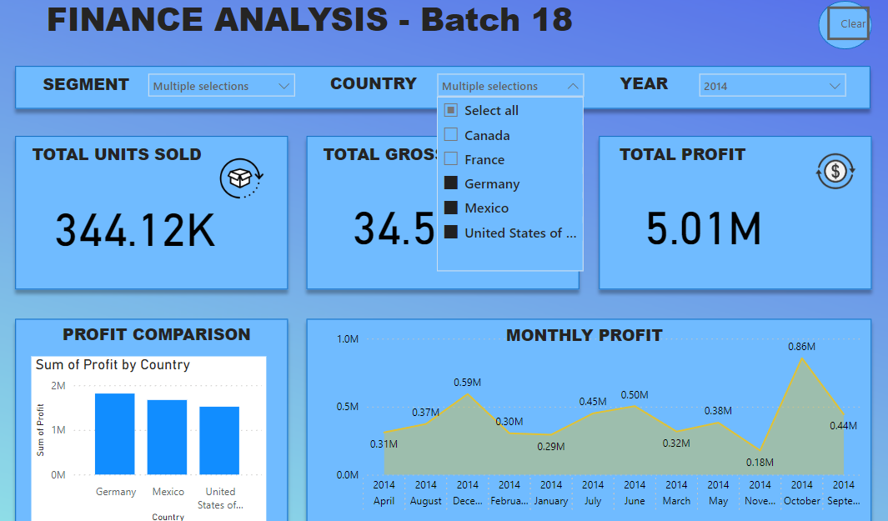
Finance Analysis Project Using Power BI
An Automated Analysis and Visualization Approach

Slide 2
Project Overview
This project involves using Power BI for analyzing financial data, automation to streamline data processing and reporting.
To analyze financial data and uncover trends, insights, and actionable metrics for better decision-making

Slide 3
Objectives and Goals
• Visualize financial KPIs and trends using Power BI.
• Automate data import and processing with VBA.
• Generate reports efficiently.

Slide 4
Data Sources and Preparation
Data is sourced from Microsoft website cleaned and transformed in Power BI for accuracy and consistency.

Slide 5
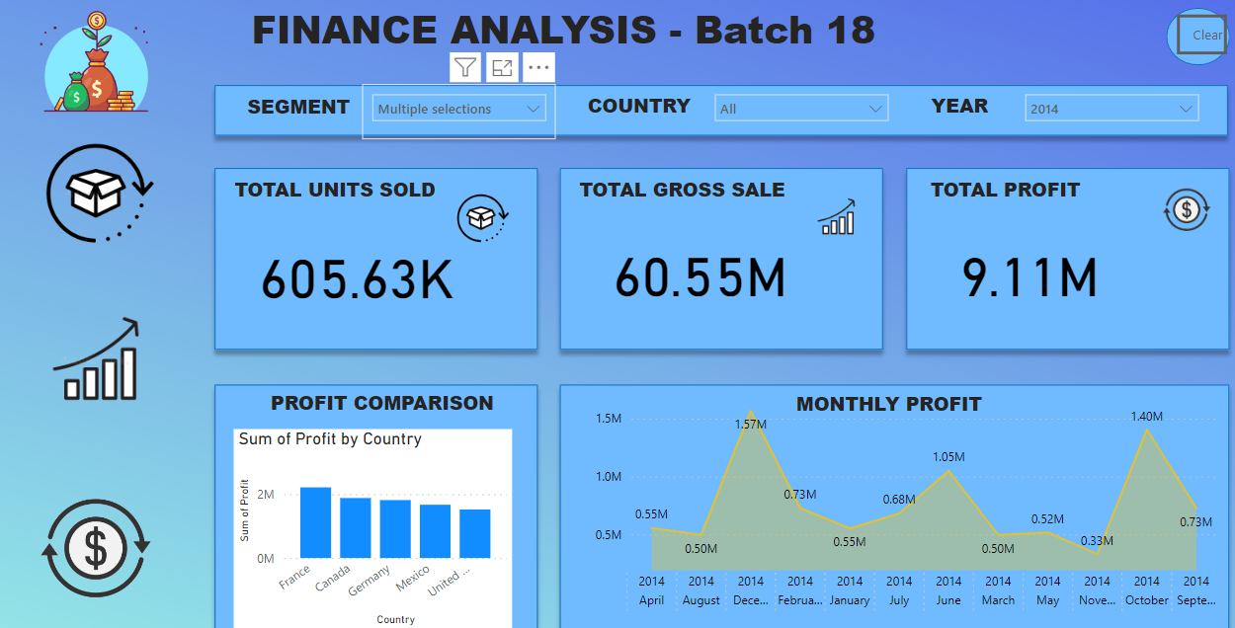

Slide 6
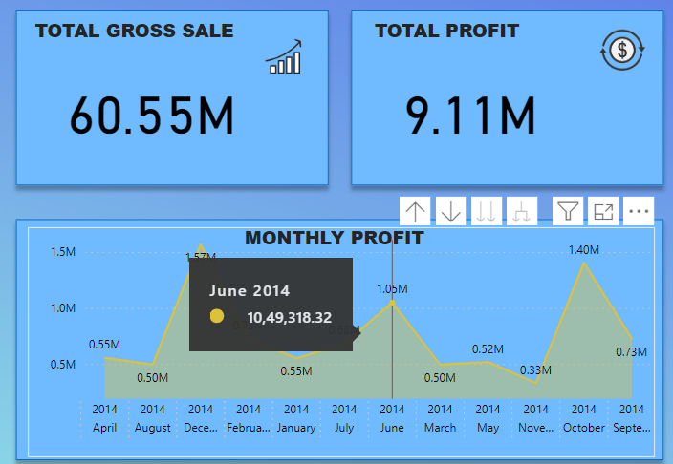
Power BI Dashboard Overview
Visualizing key financial metrics such as Revenue, Expenses, and Profit Margin.

Slide 7
Project Results and Insights
. Enhanced Financial Visibility
Insight: The analysis provided a clear view of revenue, expenses, and profit trends over time, which helped stakeholders understand the current financial health of the business.
Impact: This visibility allowed decision-makers to quickly identify positive or negative trends, allowing for timely interventions and proactive management of finances.
2. Improved Cost Management
Insight: By categorizing and analyzing expenses in detail, it was possible to identify high-cost areas and expenses that showed little return on investment.
Impact: These insights led to strategic cost-cutting measures, particularly in non-essential spending, which improved overall operational efficiency. Decision-makers could prioritize budget allocation to areas with high impact or ROI.
3. Increased Revenue Through Targeted Strategies
Insight: Revenue analysis helped identify the most profitable products, services, or customer segments.
Impact: Management could then focus sales and marketing efforts on these high-performing segments, driving revenue growth. The finance team could also collaborate with marketing to design campaigns targeting these segments, ensuring a greater ROI on marketing spend.
4. Optimized Cash Flow Management
Insight: The analysis uncovered patterns in cash inflows and outflows, including periods of high spending or revenue delays.
Impact: This information enabled the finance team to better manage cash flow, avoiding periods of low liquidity and planning for capital needs in advance. Improved cash flow management reduced the need for emergency loans and optimized working capital.

Slide 8
Conclusion
These insights showcase how combining Power BI with a robust finance analysis strategy leads to a more efficient and proactive approach to financial management. The improved visibility, efficiency, and data-driven decision-making capabilities empower the organization to optimize resources, anticipate financial needs, and make strategic, well-informed decisions.

